Slide 1


CMake – a magic tool for build management
Alex Kushnir
Biosense Webster

Slide 2
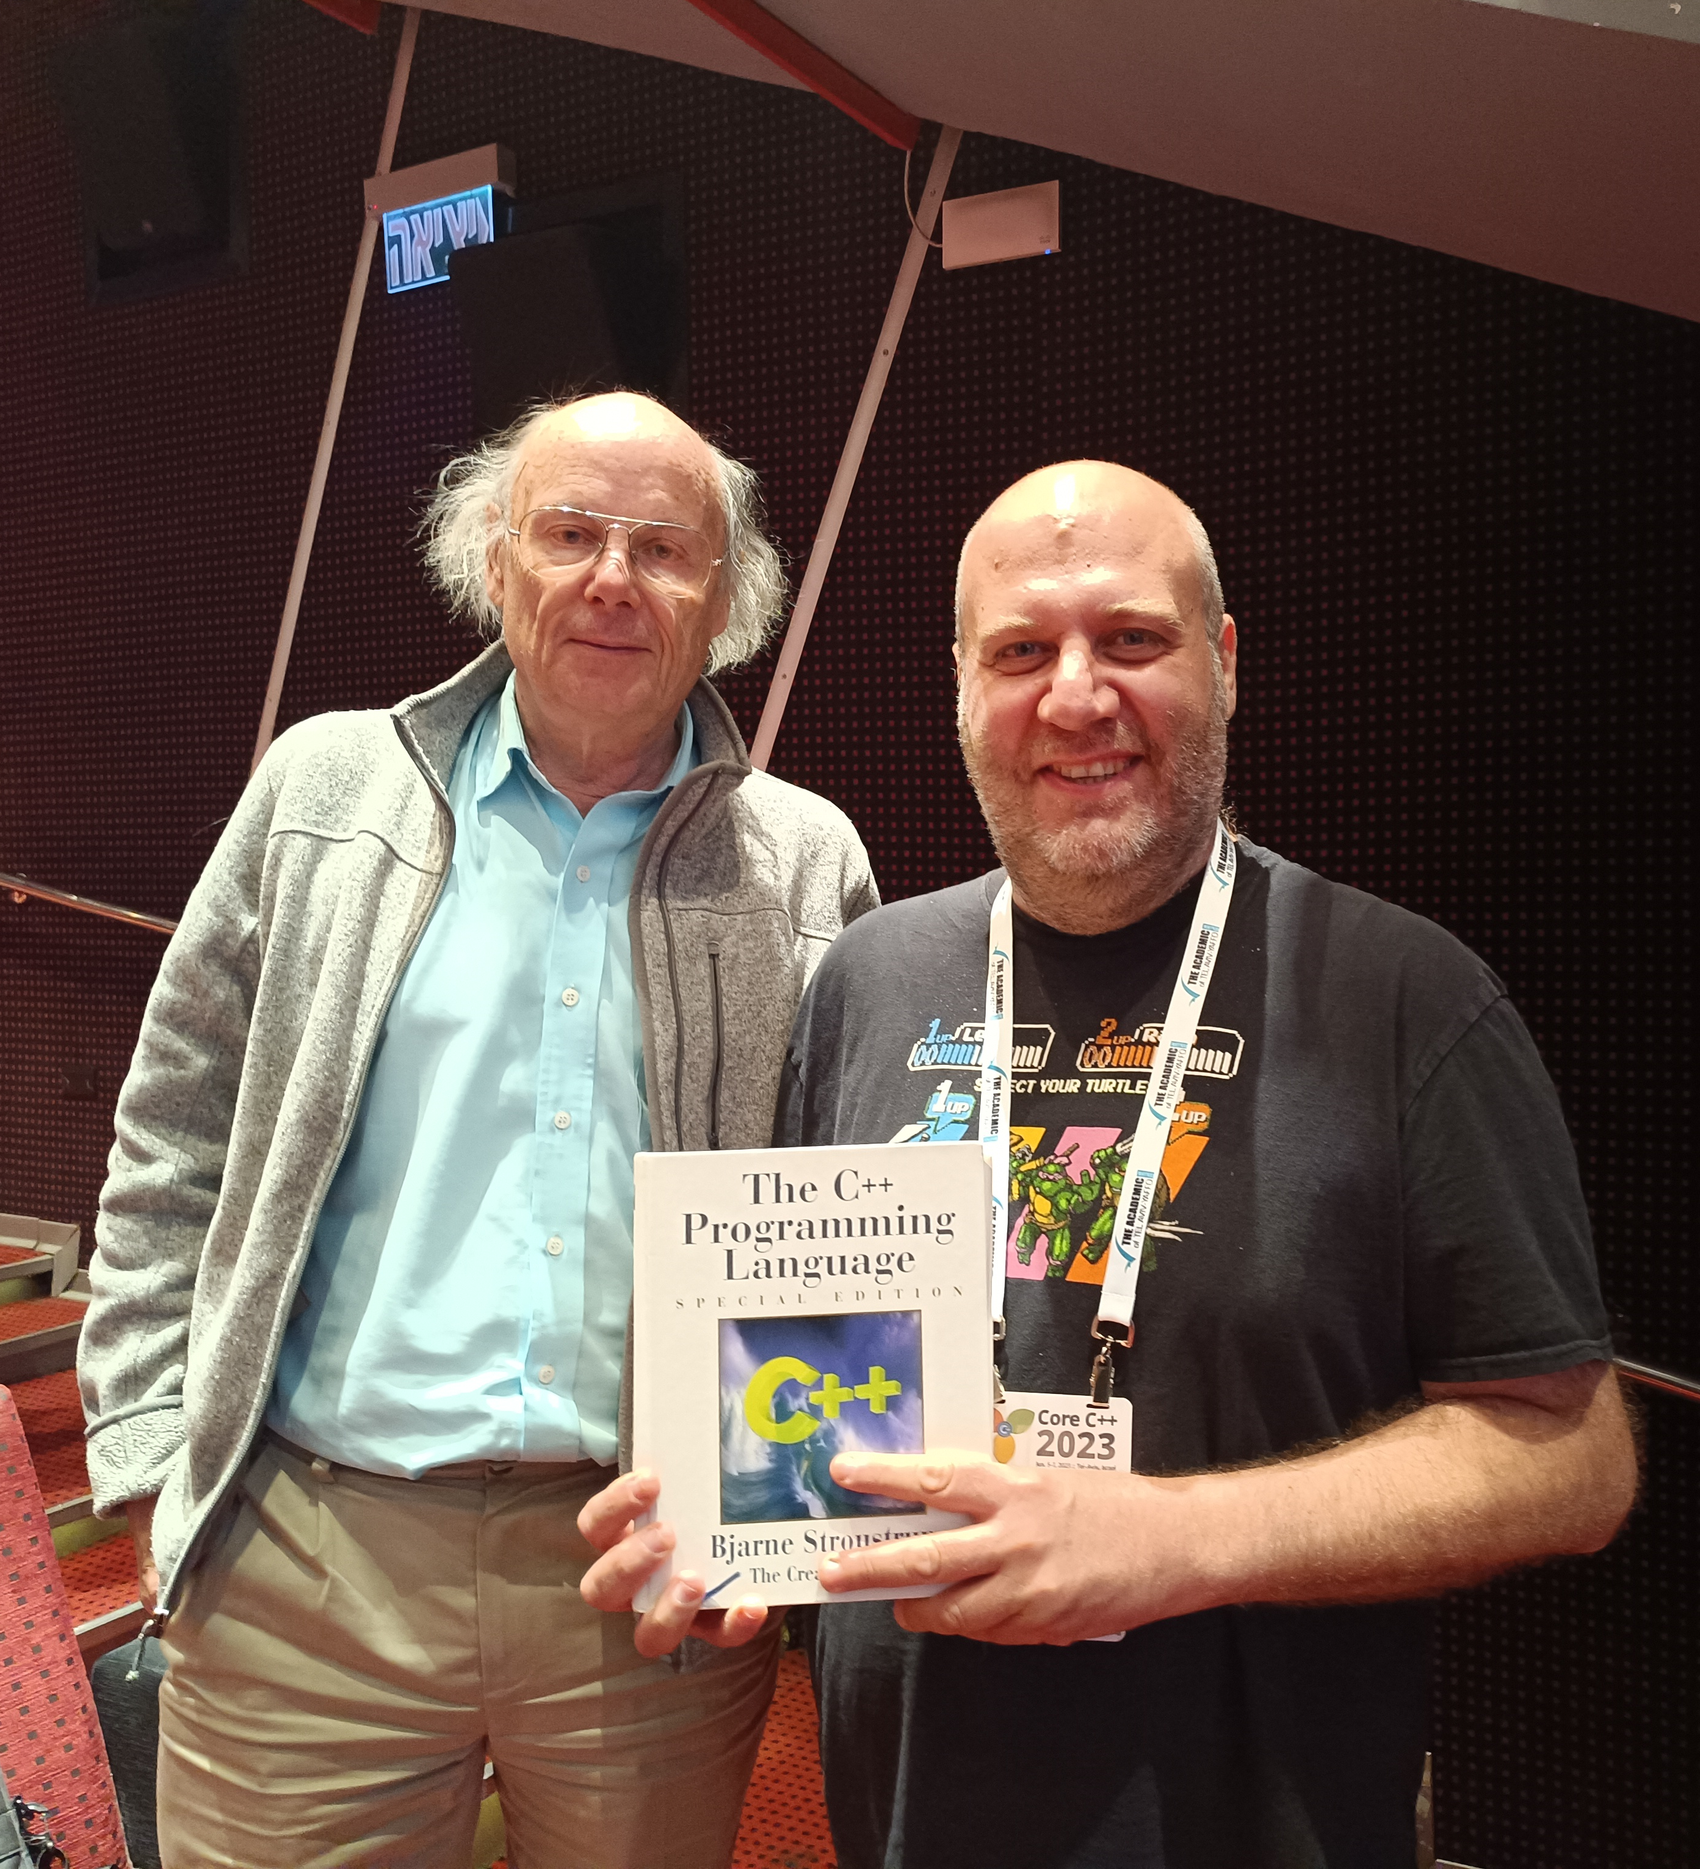
About me
Software engineer since 2007
Mostly embedded and low-level
Embedded Linux
C++
Methodologies and tools
Heavy metal \m/

Slide 3
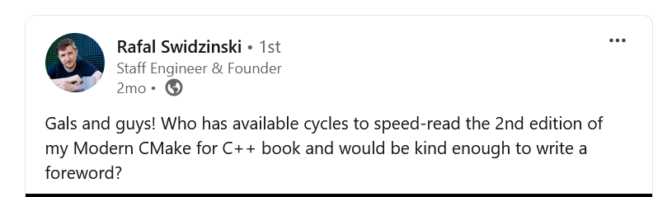
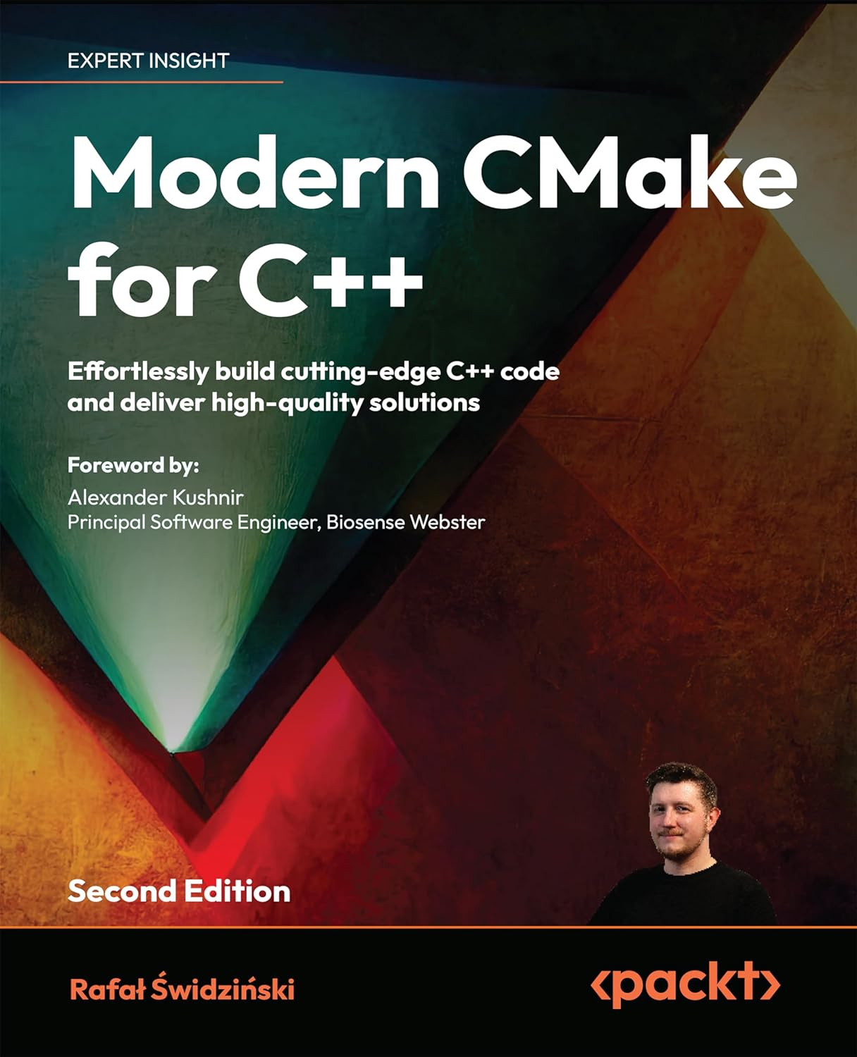



Modern CMake for C++
Click to purchase

Slide 4

About Biosense Webster
A global leader in treating complex arrhythmias
Part of the Johnson and Johnson MedTech
Large software group of professionals
Stack – C++/C#, Windows

Slide 5

Work with me
We are always hiring
Yokneam-based, hybrid mode
Scan the QR code to apply

Slide 6
TABLE OF CONTENTS.
01
02
03
04
05
06
CMake in a nutshell
Understanding the process
Working with C++20 modules
Testing with CMake
For further reading
Summary

Slide 7
CMake in a nutshell
01
<p> An open-source(BSD-3-Clause), cross-platform family of tools designed to build, test and package software </p>

Slide 8
History of CMake
Development began in 1999
Was funded by US National Library of Medicine
Inspired by pcmaker – a tool converting Makefiles to Nmake
Version 3 was released in 2014 and considered as the beginning of “Modern CMake”

Slide 9
Key features
<p> Separate build tree </p>
Ability to place compiler outputs into a build tree which is located outside of the source tree
Enables multiple builds from the same source and multi-platform compilation
<p> Dependency management</p>
Keeps track and recompiles all dependencies of a given sub-module if its sources were changed
<p> One-stop shop </p>
Ability to build, test, package and install – all in one package

Slide 10
Several alternatives
<p> Bazel </p>
+ Fast, scalable, multilanguage support
- Learning curve, configuration complexity, limited IDE support
<p> Meson </p>
+ Ease of use, fast, developer friendly
- Less mature, limited IDE support, limited language support
<p> Autotools </p>
Come on…really?

Slide 11
So…why CMake?
Focused on supporting modern compilers and toolchains
Truly cross-platform
Generates project files for all popular IDEs and CLI tools, and a project model for Clion
Tons of projects built with CMake
Testing, packaging and installing are an inherent part of the build process
Old features get deprecated

Slide 12
Understanding the process
02
<p> Let’s understand how CMake works under the hood </p>

Slide 13
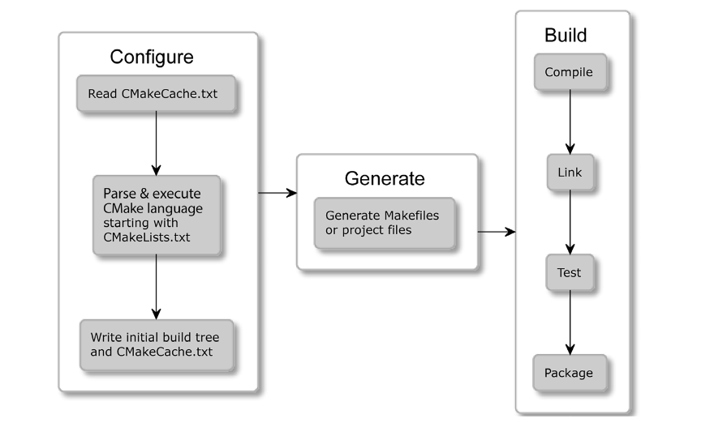
The build process stages

Slide 14
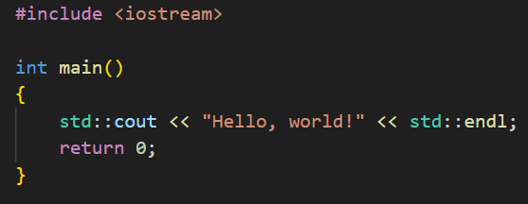
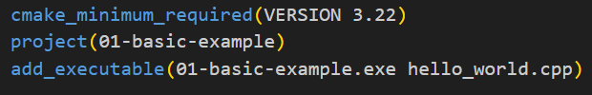
Let’s see some CODE!
A part of an extremely complex project I’ve been working on recently
Notes:
01-basic-example after the slide

Slide 15
Working with C++20 modules
03
<p> CMake now supports one of the most powerful C++20 features! </p>

Slide 16
Using C++20 modules
Required – CMake 3.28, Visual Studio 2022 v17.4 (tested with 17.10)
Recap about C++ modules
The BMI (Binary Module Interface) – like a header file, in binary format
The Module Implementation Unit – provides the implementation, definitions and internal details
Were introduced to reduce compilation time and address problematic aspects of the preprocessor
Notes:
The most important setting is the LANGUAGES

Slide 17
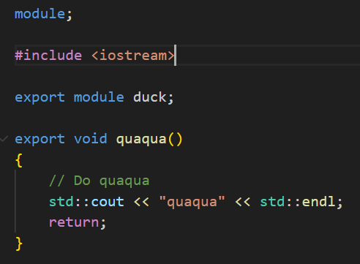
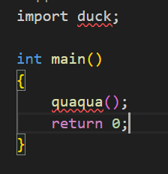
Let’s see some CODE!
A part of another top-secret project that makes computer sound like an animal!
Notes:
01-basic-example after the slide

Slide 18
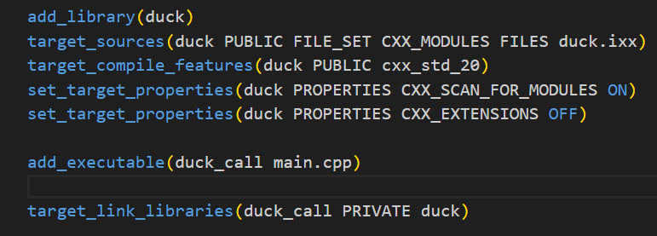
Let’s see some CMakeLists!
Instructs the compiler to treat the file as C++20 module
Ensures the library can be used in other projects
Notes:
01-basic-example after the slide

Slide 19
Testing with CMake
04
<p> Use CTest to standartize testing in CMake</p>

Slide 20
Why CTest?
<p> Simplify the process of running tests </p>
Write tests using a framework of choice
Run in a similar way
<p> Integrate seamlessly with CMake </p>
Run tests using the same environment as build
<p> Generate detailed reports and logs </p>
Reports can be used for various dashboards

Slide 21
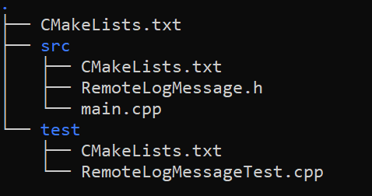
Organizing the unit tests
We’ll test the RemoteLogMessage class
Implements very basic std::format functionality (before C++20)
Assuming the following project structure
Notes:
The most important setting is the LANGUAGES

Slide 22
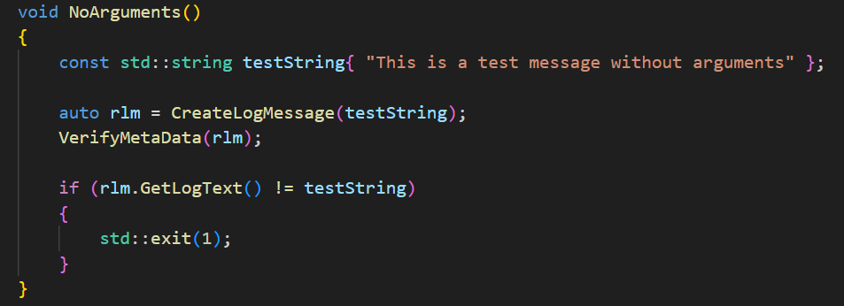
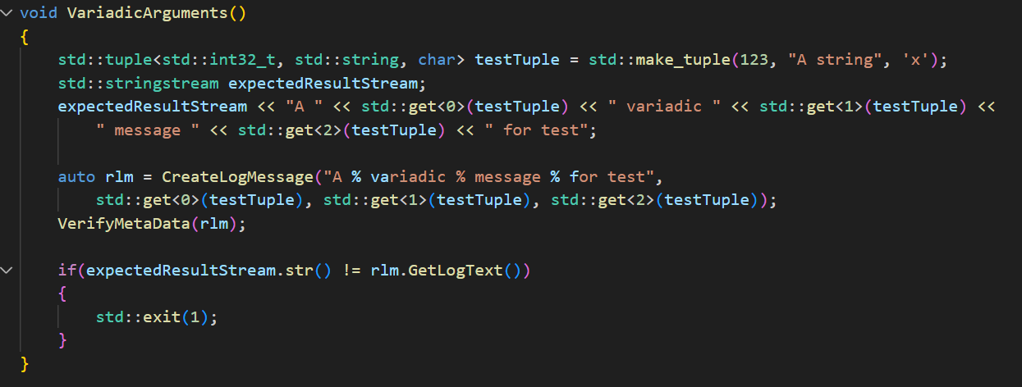
Let’s see some TEST CODE!
The class under test utilizes the RAII idiom to construct the object
Notes:
01-basic-example after the slide

Slide 23
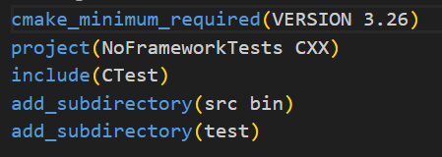
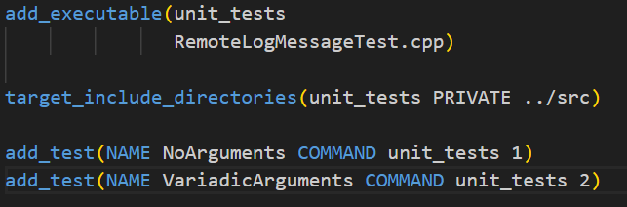
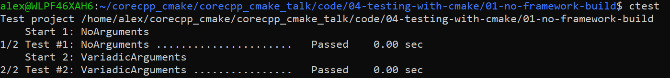
Let’s see some CMakeLists!
The class under test utilizes the RAII idiom to construct the object
Notes:
01-basic-example after the slide

Slide 24
Testing frameworks
<p> No framework </p>
Implement your own asserts and termination handlers
<p> Catch2 </p>
Easy to learn
Good support and documentation
<p> Googletest </p>
More advanced
Comes with a rich set of features
Supports mocking (using GMock)

Slide 25
For further reading
05
<p> What else? </p>

Slide 26
What else?
Integration with IDEs – Visual Studio, CLion, VSCode…
Cross-platform development
Managing dependencies with CMake – installed and not installed
Testing with frameworks and coverage reports
Static and dynamic analysis
Installing and packaging using CPack
Notes:
The most important setting is the LANGUAGES

Slide 27
Summary
06

Slide 28
A short summary of CMake
Cross-platform
Modern
Manage as code
CMake is platform-independent
Supports most modern language features
Code instead of project files
Testing
Packaging
Industry-adopted
Pipeline the unit tests
Able to package and install the artifacts
Tons of documentation and references

Slide 29

Slides and code
https://github.com/alexkushnir/corecpp_cmake_talk
Notes:
The most important setting is the LANGUAGES

Slide 30
THANK YOU!
Drop me an e-mail
Connect with me on LinkedIn
Do you have any questions?

Slide 31
CREDITS.
Presentation Template: SlidesMania
Sample Images: Unsplash
Fonts used in this presentation: Roboto Mono and Roboto Bold

